Slide 1
FHIR DSTU 2 Changes & Future Direction
Lloyd McKenzie
Oct. 28, 2015

Slide 2

Who am I?
Name: Lloyd McKenzie
Company: Gevity
Background:
One of FHIR’s 3 principle editors
Co-chair FHIR Management Group, Modeling & Methodology, FHIR Infrastructure
Former Chair HL7 Canada Architecture & Infrastructure
Heavily involved in HL7 and healthcare exchange for last 15 years (v2, v3, CDA, etc.)

Slide 3
This presentation
Can be downloaded here:
http://gforge.hl7.org/svn/fhir/trunk/presentations/2015-10 Webinars/FHIR DSTU 2.pptx
Use “anonymous” and email address to logon
Is licensed for use under the Creative Commons, specifically:
Creative Commons Attribution 3.0 Unported License
(Do with it as you wish, so long as you give credit)

Slide 4
Baseline & Objectives
Presume you already know what FHIR is
If not, grab the FHIR for Execs webinar ☺
What are the major changes in DSTU 2?
What’s coming next for FHIR?

Slide 5
DSTU 2 – evolution
DSTU 1 was published February 3, 2014
Since then, there’s been a bit of feedback
>3700 Change requests submitted to gForge
1925 from ballot comments
>>20,000 lines on FHIR Implementers Skype chat
>125 questions raised on Stack Overflow
5 HL7 WGMs + innumerable conference calls

Slide 6
DSTU 2 - evolution
>4800 Commits to the FHIR project
>30 primary committers
2444 change requests applied
659 others resulted in no change
Countless hours of development & QA time
Result: FHIR DSTU 2

Slide 7
DSTU 2 changes
We changed a lot
Almost every resource & page was impacted in some manner
Lots of new resources
More profiles
International & US implementation guides
Revisions to XML & JSON syntaxes, extensibility and other core methodology

Slide 8
Resources - statistics
DSTU 1 resources: 49
1 draft
DSTU 2 resources: 93
1 resource dropped
1 from draft to DSTU
4 from DSTU to to draft
2 merged
1 split
44 new (21 draft)

Slide 9
Resources from DSTU 1
AdverseReaction
Alert
AllergyIntolerance
Binary
CarePlan
Composition
ConceptMap
Condition
Conformance
Device
DeviceObservationReport
DiagnosticOrder
DiagnosticReport
DocumentManifest
DocumentReference
Encounter
FamilyHistory
Group
ImagingStudy
Immunization
ImmunizationRecommendation
List
Location
Media
Medication
MedicationAdministration
MedicationDispense
MedicationPrescription
MedicationStatement
MessageHeader
Observation
OperationOutcome
Order
OrderResponse
Organization
Other
Patient
Practitioner
Procedure
Profile
Provenance
Query
Questionnaire
RelatedPerson
SecurityEvent
Specimen
Substance
Supply
ValueSet

Slide 10
DSTU 2 Resources
Claim
ClaimResponse
ClinicalImpression
Contract
Coverage
EligibilityRequest
EligibilityResponse
EnrollmentRequest
EnrollmentResponse
ExplanationOfBenefit
PaymentNotice
PaymentReconciliation
ProcessRequest
ProcessResponse
EpisodeOfCare
Person
HealthcareService
Appointment
AppointmentResponse
Schedule
Slot
BodySite
Communication
CommunicationRequest
DetectedIssue
DeviceUseRequest
DeviceUseStatement
Goal
ImagingObjectSelection
NutritionOrder
ProcedureRequest
QuestionnaireResponse
ReferralRequest
RiskAssessment
VisionPrescription
(AllergyIntolerance)
Flag
AllergyIntolerance
Binary
CarePlan
Composition
ConceptMap
Condition
Conformance
Device
DeviceObservationReport
DiagnosticOrder
DiagnosticReport
DocumentManifest
DocumentReference
Encounter
FamilyMemberHistory
Group
ImagingStudy
Immunization
ImmunizationRecommendation
List
Location
Media
Medication
MedicationAdministration
MedicationDispense
MedicationOrder
MedicationStatement
MessageHeader
Observation
OperationOutcome
Order
OrderResponse
Organization
Basic
Patient
Practitioner
Procedure
StructureDefinition
SearchParameter
Provenance
OperationDefinition
Questionnaire
RelatedPerson
AuditEvent
Specimen
Substance
SupplyRequest
SupplyDelivery
ValueSet
DeviceComponent
DeviceMetric
Bundle
DataElement
ImplementationGuide
NamingSystem
Parameters
Subscription
TestScript

Slide 11
Maturity levels
Intended to indicate level of stability
FMM1 – Resource is “done”, no build warnings
FMM2 – Tested at approved Connectathon
FMM3 – Passes QA, has passed ballot
FMM4* – Tested across scope, published, prototype implementation
FMM5* – 5 distinct production implementations, multiple countries, 2
Non-compatible changes at level 4 and 5 will face increased hurdles

Slide 12
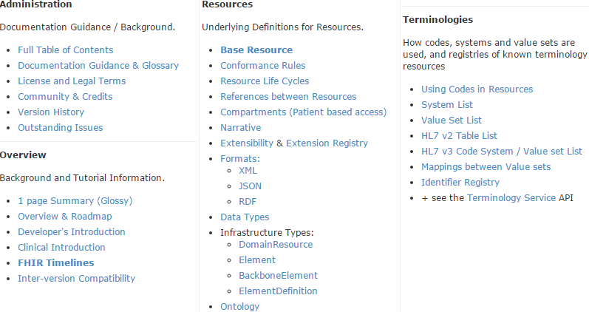
Documentation Page

Slide 13
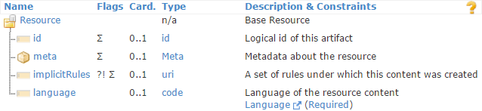
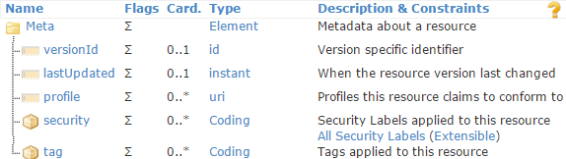
Metadata in the Resource

Slide 14
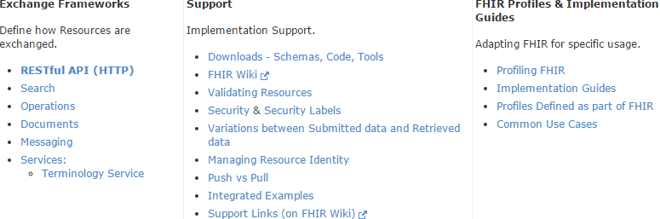
Implementation Page

Slide 15
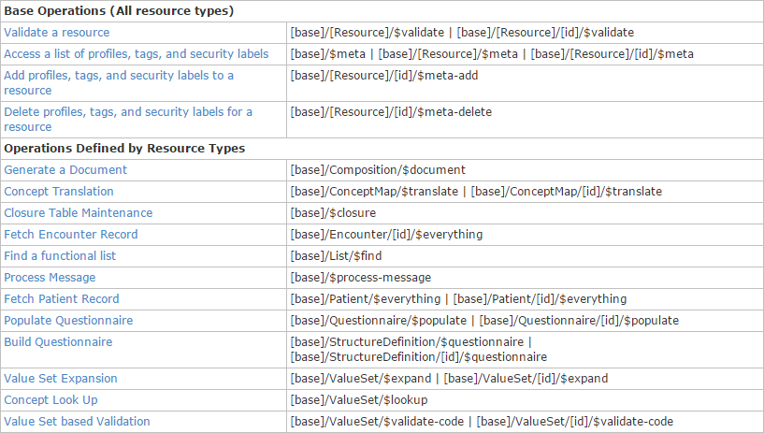
Example services

Slide 16
Implementation Page
I

Slide 17
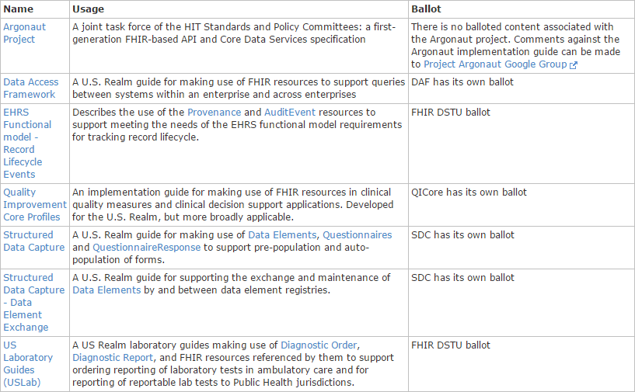
Implementation Guides

Slide 18
Additional changes
XML & JSON revised to reduce overhead of extensions
Significant enhancements to search
Improvements to rendering
Table view, JSON view
Specification itself is now RESTful
Disqus removed
Will be replaced with a FHIR.org discussion link

Slide 19
What’s next?

Slide 20
FHIR Timeline (planned)
First Draft
1st
DSTU
~ 2nd
DSTU
~ 1st
Norm.
~ 2nd
Norm.
. . .
DSTU 2.1
2011
2012
2013
2014
2015
2016
2017
2018
2019
2020
Notes:
Note that dates are subject to change based on resources and the standards process

Slide 21
DSTU 2.1
Limited release
Some resources are “frozen”
Ballot in April, 2016
Publication in Summer, 2016
Principle scope:
Move draft resources to DSTU status
Resolve open issues with FHIR “workflow”
Move non-frozen resources up FMM scale

Slide 22
DSTU 2 Resources
Claim
ClaimResponse
ClinicalImpression
Contract
Coverage
EligibilityRequest
EligibilityResponse
EnrollmentRequest
EnrollmentResponse
ExplanationOfBenefit
PaymentNotice
PaymentReconciliation
ProcessRequest
ProcessResponse
EpisodeOfCare
Person
HealthcareService
Appointment
AppointmentResponse
Schedule
Slot
BodySite
Communication
CommunicationRequest
DetectedIssue
DeviceUseRequest
DeviceUseStatement
Goal
ImagingObjectSelection
NutritionOrder
ProcedureRequest
QuestionnaireResponse
ReferralRequest
RiskAssessment
VisionPrescription
Flag
AllergyIntolerance
Binary
CarePlan
Composition
ConceptMap
Condition
Conformance
Device
DiagnosticOrder
DiagnosticReport
DocumentManifest
DocumentReference
Encounter
FamilyMemberHistory
Group
ImagingStudy
Immunization
ImmunizationRecommendation
List
Location
Media
Medication
MedicationAdministration
MedicationDispense
MedicationOrder
MedicationStatement
MessageHeader
Observation
OperationOutcome
Order
OrderResponse
Organization
Basic
Patient
Practitioner
Procedure
StructureDefinition
SearchParameter
Provenance
OperationDefinition
Questionnaire
RelatedPerson
AuditEvent
Specimen
Substance
SupplyRequest
SupplyDelivery
ValueSet
DeviceComponent
DeviceMetric
Bundle
DataElement
ImplementationGuide
NamingSystem
Parameters
Subscription
TestScript

Slide 23
FHIR “Release 3”
Full release
May include changes to “frozen” resources
First opportunity for content to go normative
Whether content goes normative and what goes normative will depend on:
Degree of implementation
Confidence of work groups
Feedback from the community

Slide 24
Future releases
Add more resources
Move existing resources up FMM track
And, as readiness allows, to normative
Add profiles on existing resources
May add elements to resources
Very rare

Slide 25
What else is coming?
Soon
FHIR Registry for conformance artifacts
FHIR.org community site
More connectathons
Pre-requisite for moving up the FMM track
Let the FHIR Management Group know if you’re interested in organizing one
CDA & CCDA on FHIR
Either 2.1 or 3.0 (provide resources if you want it sooner . . .)

Slide 26
Next Steps
For you and your organization

Slide 27


Education opportunities
Attend a Working Group Meeting
Tutorials, Connectathons
January 9-15 Orlando
May 7-13 Montreal
Attend an Implementation Workshop
Intensive tutorials, hands-on
November 16-18 Dallas
FHIR Institute Webinars
December 7-11
FHIR Developer Days
Amsterdam Nov 18-20th

Slide 28






International HL7 FHIR Developer Days November 18-20, 2015 in Amsterdam
Education
34 tutorials/presentations
pick & choose
Connectathon
Meet fellow developers
Put FHIR to the test
Networking
FHIR experts and authors on hand
http://fhir.furore.com/devdays

Slide 29

Questions?
http://hl7.org/fhir lmckenzie@gevityinc.com

